Slide 1
Hardware
hacking
Leon Bonde Larsen et al.

Slide 2
Repetition
What are the main attack surfaces of a computer?
What is a keylogger and how can you protect against it?
What is a virtual user device and how to protect against it?
What is a network tap and how can you protect against it?
Explain the timing side-channel attack for a simple password.
Explain the reasons for hacking hardware
What is disassembly and how can we protect against it?
Explain virtual memory
Explain the anatomy of a program in memory
Explain fault attacks
Explain rowhammer
Explain meltdown
Notes:
Network, software, physical

Slide 3
Fault attacks
Provoke faults by:
Heat
Radiation
Unintended use
Laser
Electro-magnetic impulse
UV light
...

Slide 4
Fault types
Stuck-at faults
Bit-flip faults
Set/reset faults
Random faults
Transient
Permanent
Destructive
Precise control
Loose control
No control
Notes:
Types
Duration
Control. Location. Time
Precision. Single-bit, few bits, byte/word

Slide 5
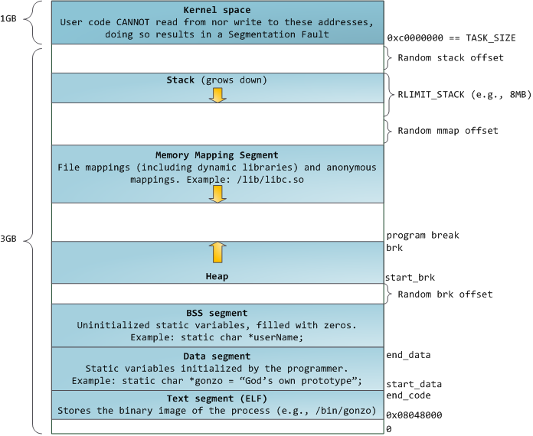
Virtual memory
source: https://manybutfinite.com/post/anatomy-of-a-program-in-memory/

Slide 6
Rowhammer

Slide 7
DRAM cell

Slide 8
DRAM cell
Word line

Slide 9
DRAM cell
Word line
Bit line

Slide 10
DRAM cell
Word line
Bit line = 1

Slide 11
DRAM cell
Word line = 1
Bit line = 1

Slide 12
DRAM cell
Word line = 1
Bit line = 1

Slide 13
DRAM cell
Word line = 1
Bit line = 1

Slide 14
DRAM cell
Word line = 1
Bit line = 0

Slide 15
DRAM cell
Word line = 1
Bit line = 0

Slide 16
DRAM cell
Word line = 1
+
-
1

Slide 17
DRAM cell
Word line = 1
+
-
0

Slide 18
Rowhammer

Slide 19
Rowhammer
0 1 1 0 0 0 0 1

Slide 20
Rowhammer
0 1 1 0 0 0 0 1

Slide 21
Rowhammer
0 1 1 0 0 0 0 1

Slide 22
Rowhammer
0 1 1 0 0 0 0 1

Slide 23
Rowhammer

Slide 24
Rowhammer

Slide 25
Rowhammer

Slide 26
Rowhammer
0 1 1 0 0 0 0 1

Slide 27
Rowhammer
0 1 1 0 0 0 0 1

Slide 28
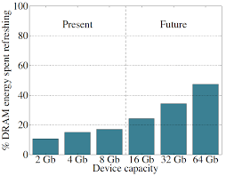
Refresh

Slide 29
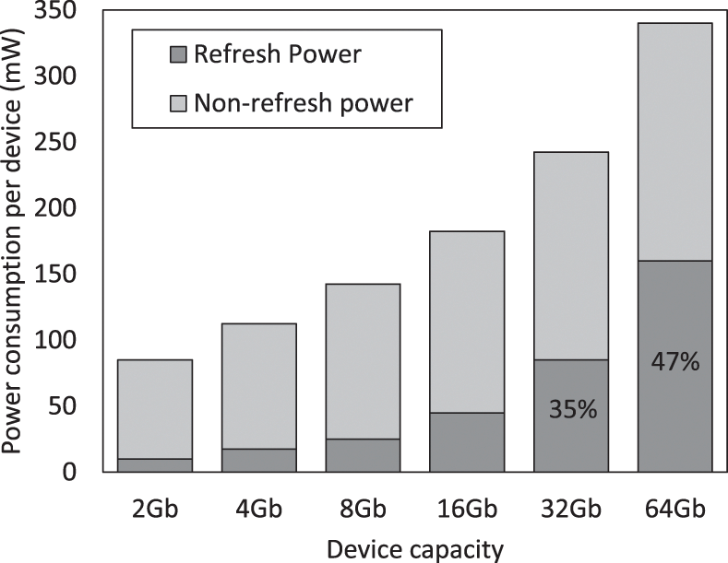
Refresh

Slide 30
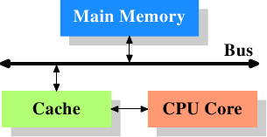
Cache memory

Slide 31
Cache memory
DRAM
L2
L1
CPU 0
L1
CPU 1

Slide 32
Cache memory
DRAM
L2
L1
CPU 0
L1
CPU 1
?

Slide 33
Cache memory
DRAM
L2
L1
CPU 0
L1
CPU 1
?
?

Slide 34
Cache memory
DRAM
L2
L1
CPU 0
L1
CPU 1
?
?
?

Slide 35
Cache memory
DRAM
L2
L1
CPU 0
L1
CPU 1
?
?
?

Slide 36
Cache memory
DRAM
L2
L1
CPU 0
L1
CPU 1
?
?
?

Slide 37
Cache memory
DRAM
L2
L1
CPU 0
L1
CPU 1
?
?
?

Slide 38
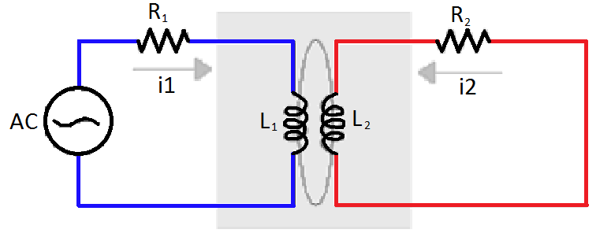
Electromagnetic coupling

Slide 39
Code
hammer:
mov (X), %eax
mov (Y), %ebx
clflush (X)
clflush (Y)
jmp hammer
1.2M times per refresh (64ms)

Slide 40
Example

Slide 41
Example
Physical memory
Program memory
0x0000
0x0001
0x0002
0x0003
0x0004
0x0005
0x0006
0x0007
0x0008
0x0009
0x000A
0x000B
0x000C
.
.
0x00FF
0x0000
0x0001
0x0002
0x0003
0x0004
0x0005
0x0006
0x0007
0x0008
0x0009
0x000A
0x000B
0x000C
.
.
0x00FF

Slide 42
Example
Physical memory
Program memory
Step 1: Allocate shared memory

Slide 43
Example
Physical memory
Program memory
/dev/shm

Slide 44
Example
Physical memory
Program memory
/dev/shm
access via page table

Slide 45
Page tables
A page is a fixed length, typically 4k
The page table is 4k = 1 page
Stores the mapping between virtual and physical memory
Up to 512 entries in a page table
512x4k = 2MB
Every 2MB requires 4k page table

Slide 46
Example
Physical memory
Program memory
Step 2: mmap the shared file

Slide 47
Example
Physical memory
Program memory

Slide 48
Example
Physical memory
Program memory

Slide 49
Example
Physical memory
Program memory
Step 3: Repeat many many times

Slide 50
Example
Physical memory
Program memory

Slide 51
Example
Physical memory
Program memory
Step 4: Induce a lucky bit-flip

Slide 52
Example
Physical memory
Program memory

Slide 53
Example
Physical memory
Program memory

Slide 54
Example
Physical memory
Program memory
Step 5: Write your own page table

Slide 55
Privilege escalation
Find SUID program (i.e. ping)
Overwrite that program with your own code
Run your own code as root….

Slide 56
Protection
Larger capacitors
Shorter refresh period
Disable clflush

Slide 57
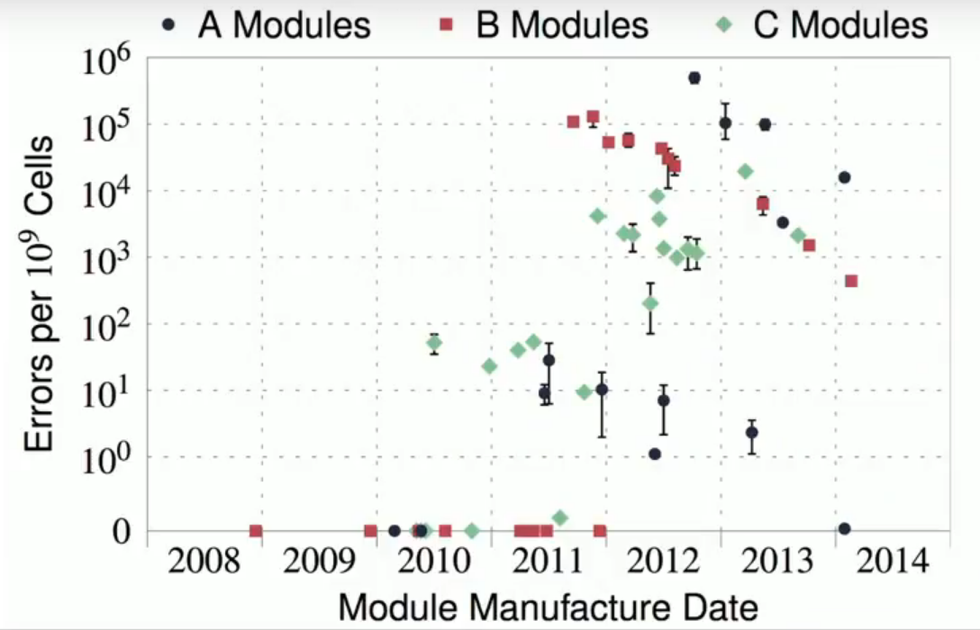
Number of errors
Source: "Flipping Bits in Memory Without Accessing Them: An Experimental Study of DRAM Disturbance Errors

Slide 58
Test it yourself...
https://github.com/google/rowhammer-test

Slide 59
Meltdown

Slide 60
Cache memory
DRAM
L2
L1
CPU 0
L1
CPU 1
?
?
?

Slide 61
Virtual memory
source: https://manybutfinite.com/post/anatomy-of-a-program-in-memory/

Slide 62
Out-of-order execution

Slide 63
Out-of-order execution
load X
load Y
load Z
add X,Y,R1
add R1,Z,R2

Slide 64
Out-of-order execution
load X -cache miss
load Y
load Z
add X,Y,R1
add R1,Z,R2

Slide 65
Out-of-order execution
1 | 2 | 3 | 4 | 5 | 6 | 7 | 8 | 9 | 10
load X
load Y
load Z
add X,Y,R1
add R1,Z,R2

Slide 66
Out-of-order execution
1 | 2 | 3 | 4 | 5 | 6 | 7 | 8 | 9 | 10
load X
load Y
load Z
add X,Y,R1
add R1,Z,R2

Slide 67
Out-of-order execution
1 | 2 | 3 | 4 | 5 | 6 | 7 | 8 | 9 | 10
load X
load Y
load Z
add X,Y,R1
add R1,Z,R2

Slide 68
Out-of-order execution
1 | 2 | 3 | 4 | 5 | 6 | 7 | 8 | 9 | 10
load X
load Y
load Z
add X,Y,R1
add R1,Z,R2

Slide 69
Out-of-order execution
1 | 2 | 3 | 4 | 5 | 6 | 7 | 8 | 9 | 10
load X
load Y
load Z
add X,Y,R1
add R1,Z,R2

Slide 70
Out-of-order execution
1 | 2 | 3 | 4 | 5 | 6 | 7 | 8 | 9 | 10
load X
load Y
load Z
add X,Y,R1
add R1,Z,R2

Slide 71
Out-of-order execution
1 | 2 | 3 | 4 | 5 | 6 | 7 | 8 | 9 | 10
load X
load Y
load Z
add X,Y,R1
add R1,Z,R2

Slide 72
Out-of-order execution
1 | 2 | 3 | 4 | 5 | 6 | 7 | 8 | 9 | 10
load X
load Y
load Z
add X,Y,R1
add R1,Z,R2

Slide 73
Out-of-order execution
1 | 2 | 3 | 4 | 5 | 6 | 7 | 8 | 9 | 10
load X
load Y
load Z
add X,Y,R1
add R1,Z,R2

Slide 74
Out-of-order execution
1 | 2 | 3 | 4 | 5 | 6 | 7 | 8 | 9 | 10
load X
load Y
load Z
add X,Y,R1
add R1,Z,R2

Slide 75
Out-of-order execution
1 | 2 | 3 | 4 | 5 | 6 | 7 | 8 | 9 | 10
load X
load Y
load Z
add X,Y,R1
add R1,Z,R2

Slide 76
Out-of-order execution
1 | 2 | 3 | 4 | 5 | 6 | 7 | 8 | 9 | 10
load X
load Y
load Z
add X,Y,R1
add R1,Z,R2

Slide 77
Out-of-order execution
1 | 2 | 3 | 4 | 5 | 6 | 7 | 8 | 9 | 10
load X
load Y
load Z
add X,Y,R1
add R1,Z,R2

Slide 78
Out-of-order execution
1 | 2 | 3 | 4 | 5 | 6 | 7 | 8 | 9 | 10
load X
load Y
load Z
add X,Y,R1
add R1,Z,R2

Slide 79
Out-of-order execution
1 | 2 | 3 | 4 | 5 | 6 | 7 | 8 | 9 | 10
load X
load Y
load Z
add X,Y,R1
add R1,Z,R2

Slide 80
Out-of-order execution
1 | 2 | 3 | 4 | 5 | 6 | 7 | 8 | 9 | 10
load X
load Y
load Z
add X,Y,R1
add R1,Z,R2

Slide 81
Out-of-order execution
load X
breq,X,0
jmp L
load Y
L: nop

Slide 82
Branch prediction
1 | 2 | 3 | 4 | 5 | 6 | 7 | 8 | 9 | 10
load X
breq,X,0
jmp L
load Y
L: nop

Slide 83
Branch prediction
1 | 2 | 3 | 4 | 5 | 6 | 7 | 8 | 9 | 10
load X
breq,X,0
jmp L
load Y
L: nop

Slide 84
Branch prediction
1 | 2 | 3 | 4 | 5 | 6 | 7 | 8 | 9 | 10
load X
breq,X,0
jmp L
load Y
L: nop
?

Slide 85
Branch prediction
1 | 2 | 3 | 4 | 5 | 6 | 7 | 8 | 9 | 10
load X
breq,X,0
jmp L
load Y
L: nop
?

Slide 86
Branch prediction
1 | 2 | 3 | 4 | 5 | 6 | 7 | 8 | 9 | 10
load X
breq,X,0
jmp L
load Y
L: nop
?

Slide 87
Branch prediction
1 | 2 | 3 | 4 | 5 | 6 | 7 | 8 | 9 | 10
load X
breq,X,0
jmp L
load Y
L: nop
?

Slide 88
Branch prediction
1 | 2 | 3 | 4 | 5 | 6 | 7 | 8 | 9 | 10
load X
breq,X,0
jmp L
load Y
L: nop
false

Slide 89
Branch prediction
1 | 2 | 3 | 4 | 5 | 6 | 7 | 8 | 9 | 10
load X
breq,X,0
jmp L
load Y
L: nop
false

Slide 90
Branch prediction
1 | 2 | 3 | 4 | 5 | 6 | 7 | 8 | 9 | 10
load X
breq,X,0
jmp L
load Y
L: nop
false

Slide 91
Branch prediction
1 | 2 | 3 | 4 | 5 | 6 | 7 | 8 | 9 | 10
load X
breq,X,0
jmp L
load Y
L: nop
false

Slide 92
Cache timing attack
Fetch from cache takes ~4 clock cycles
Fetch from RAM takes ~200 clock cycles

Slide 93
Example
char detectArray[256 * 64];

Slide 94
Example
char detectArray[256 * 64];
flush_cache(detectArray);

Slide 95
Example
char detectArray[256 * 64];
flush_cache(detectArray);
try {
} catch (segfault) {}

Slide 96
Example
char detectArray[256 * 64];
flush_cache(detectArray);
try {
char a = *kernel_address; //page fault
} catch (segfault) {}

Slide 97
Example
char detectArray[256 * 64];
flush_cache(detectArray);
try {
char a = *kernel_address; //page fault
detectArray[a * 64]++; // speculative
} catch (segfault) {}

Slide 98
Example
char detectArray[256 * 64];
flush_cache(detectArray);
try {
char a = *kernel_address; //page fault
detectArray[a * 64]++; // speculative
} catch (segfault) {}
for (int i = 0; i < 256; i++) {
}

Slide 99
Example
char detectArray[256 * 64];
flush_cache(detectArray);
try {
char a = *kernel_address; //page fault
detectArray[a * 64]++; // speculative
} catch (segfault) {}
for (int i = 0; i < 256; i++) {
if ( in_cache(detectArray[i * 64]) )
}

Slide 100
Example - Meltdown
char detectArray[256 * 64];
flush_cache(detectArray);
try {
char a = *kernel_address; //page fault
detectArray[a * 64]++; // speculative
} catch (segfault) {}
for (int i = 0; i < 256; i++) {
if ( in_cache(detectArray[i * 64]) )
printf(*Secret is %d\n”, i);
}

Slide 101
Test it yourself...
https://github.com/IAIK/meltdown

